Slide 1


Boulder2Vec
Ethan Baron, Victor Hau, Zeke Weng
Notes:
Intros: I am Victor. I am Zeke.
This project is our approach to how we can get more insights into the data of bouldering competitions.

Slide 2
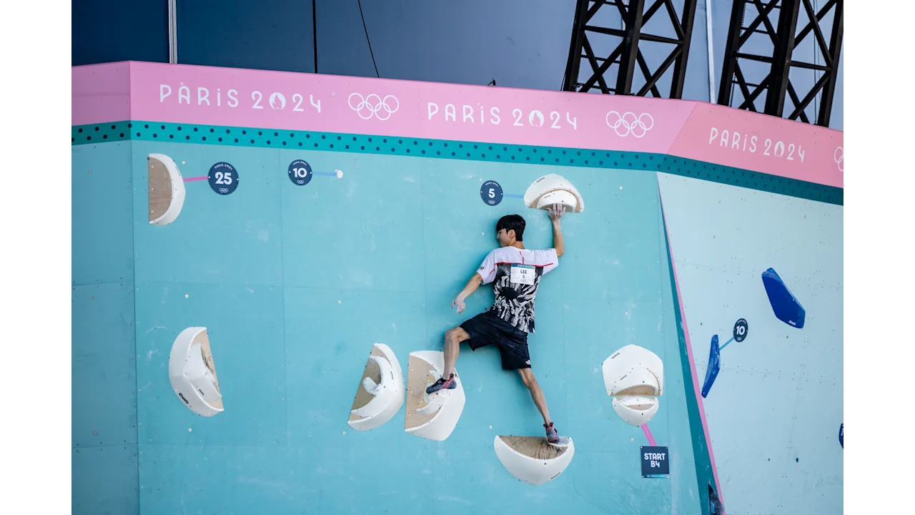


What is Bouldering?
Notes:
How many of you have heard of bouldering?
How many of you have been bouldering?
If you have ever been or heard of rock climbing, you can imagine its just like that, except in competitive bouldering there is a timed aspect so you can keep trying to climb until your time is up, trying to reach the top.
Yeah so bouldering is a pretty popular activity, and some of you may know it was featured for the first time in the 2020 Tokyo Olympics, and again in the Paris Olympics this year. The International Federtaion of Sports Climbing actually hosts a series of competitions, with bouldering being one of the competition categories and this is where we got our data from, from 2007 to 2022.
So I think the most straightforward you can ask about competitive bouldering is what is the probability that this climber succeeds on a specific climb, also called a problem.
Victor

Slide 3
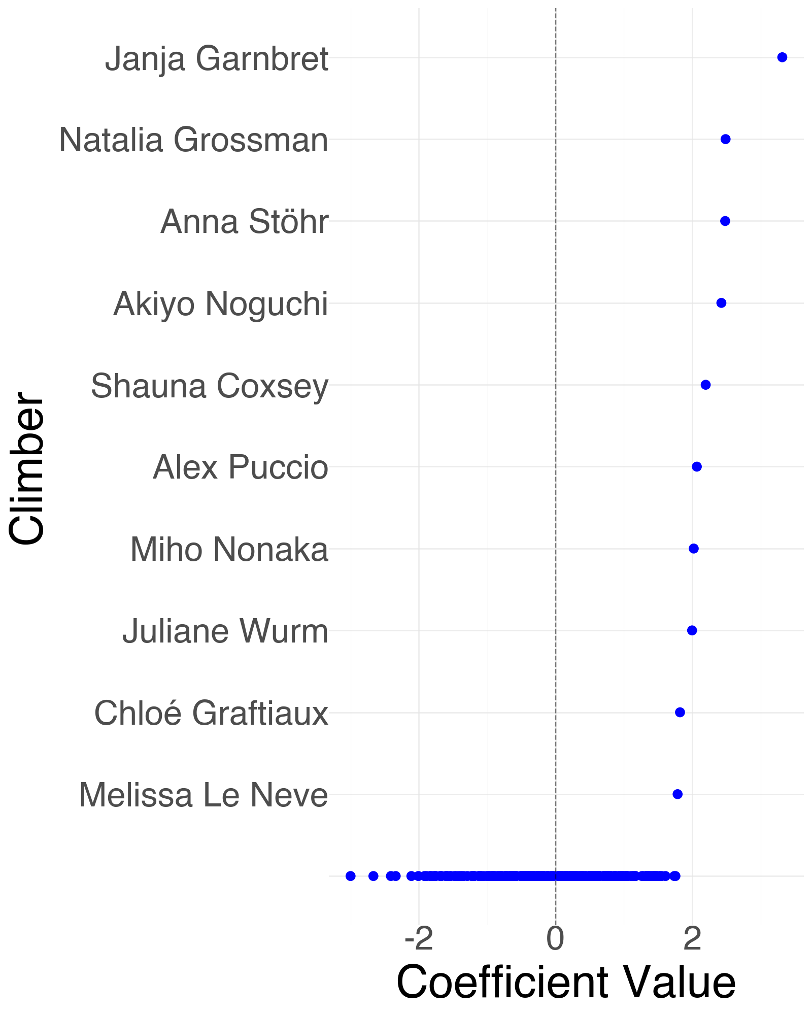


Base Model – Logistic Regression
Top Climbers
Highest Coefficients
Janja Garnbret
Anna Stöhr
Akiyo Noguchi
Natalia Grossman
Alex Puccio
Janja Garnbret
Natalia Grossman
Anna Stöhr
Akiyo Noguchi
Shauna Coxsey
Alex Puccio
Notes:
And so that’s what we did with a very simple logistic regression. We first gathered some consensus on who were the top 5 climbers over the psat couple of decades by aggregating online sources, and then fitting a logistic regression model for the climbers in our dataset. As you can see, familiar names are at the top with the highest coefficients, and people such as Janja Garnbret are known to be very good and basically the GOAT.
Victor

Slide 4
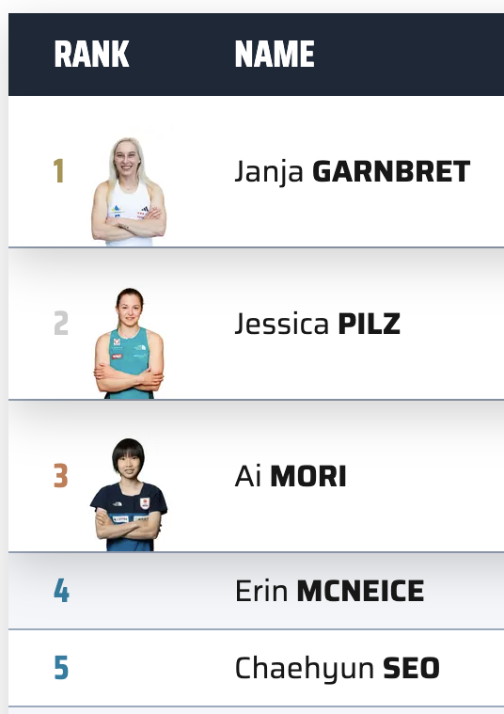
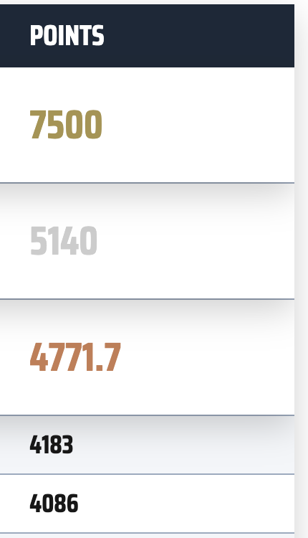
Limitations of LR
Why is a climber good?
- Accuracy: 0.723
- General prediction
- Lacks nuance
Notes:
But one thing we haven’t noted, is the nuance behind bouldering competitions in both the climber and the actual problem they’re trying to solve
So logistic regression doesn’t give us a lot of insight into the climber’s styles or intricacies, now this is probably reflected in the mediocre accuracy of the model in predicting climber success. Furthermore, we would also like to know more about the route/problem.
Victor

Slide 5
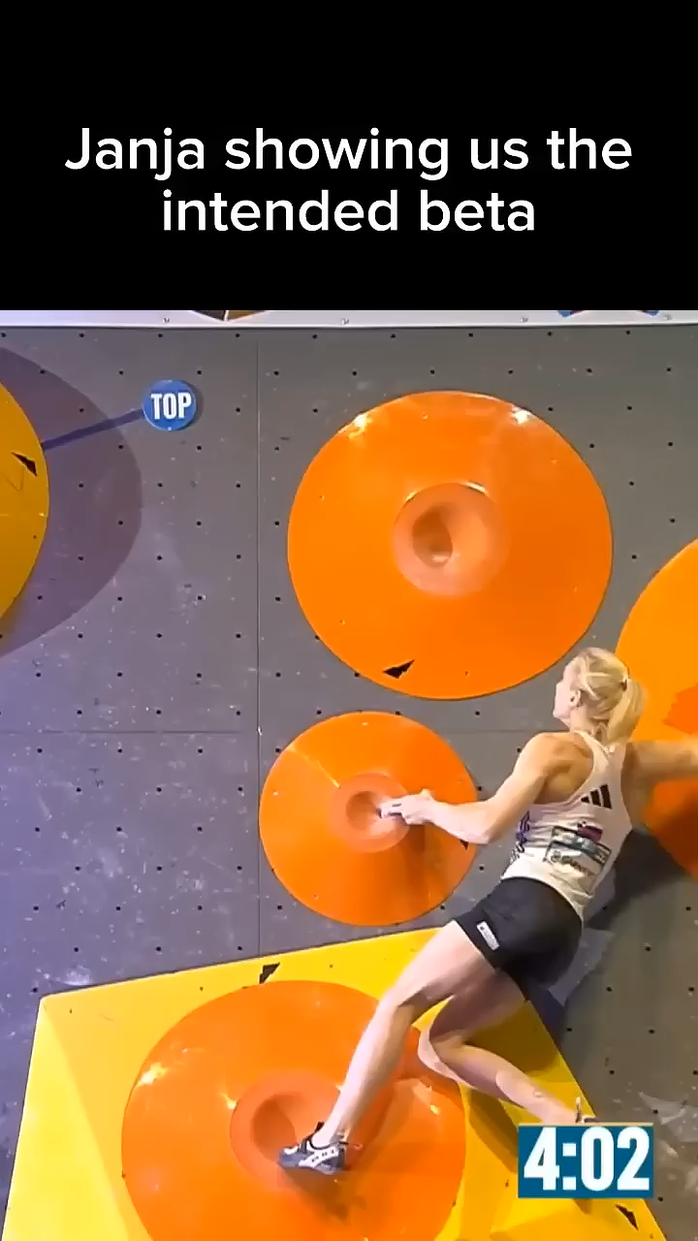
Limitations of LR
Why is a climber good?
When is a climber good?
- Accuracy: 0.723
- General prediction
- Lacks nuance
Notes:
One thing that we haven’t noted yet, is that every bouldering problem is different. For every competition and every round of competition, climbers face a unique route that they have to figure out for the first time. Bouldering problems vary a ton and for every competition and round of competition,
<play video>
and in this video with the rank 1 and current rank 3 women’s boulder competitors, which actually went viral, we see that in the same route Janja can reach the end hold but Ai who is 4 inches shorter, has to go with a different strategy. So we can see how problems impact success, and the logistic regression won’t tell us anything about the interaction between a specific route and climber.
Victor

Slide 6
Intuition
Climber
0.24
-2.45
1.82
-3.30
Prediction
Problem
3.65 1.20 2.60 0.59
0.72
Notes:
Zeke
Right – With those challenges in mind, we sought a better approach that could maybe model these intricacies.
First, we need to be able to capture the characteristics of the Problem.
Second, we need to capture the characteristics of the Climber.
And then, perform some operation with respect to these components to make a prediction.
If that sounds familiar to you, then you passed Linear Algebra. These relationship can be captured through matrices that represent climbers and problems.

Slide 7
Probabilistic Matrix Factorization
Climbers
Latent Factors
0 | 1 | 1 |  |  | 0 | 0
1 |  | 1 | 0 | 1 | 1
0 | 0 |  |  |  | 0
 |  | 0 | 0 | 1
 | 0 | 0 |  | 0 | 1 | 1
1 |  |  | 0 |  | 0
0 | 1 |  | 0 |  |  | 0
0.52 | 0.31
0.00 | 0.89
0.79 | 0.79
0.60 | 0.86
0.54 | 1.00
0.60 | 0.86
0.73 | 0.47
Climbers
0.60 | 0.73 | 0.59 | 0.79 | 0.60 | 0.59 | 0.74
0.86 | 0.47 | 0.64 | 0.79 | 0.86 | 0.91 | 0.87
Problems
Problems
Latent Factors
Notes:
Zeke
Now if take a step back, lets understand the data we have.
We have lots of data from the IFSC that details climber binary successes across problems throughout the years.
Matrix Factorization – Specifically one that can handle some of limitations in the data.
Sparsity, LF, overfitting
Probabilistic Matrix Factorization, commonly used for collaborative filtering was the perfect fit.

Slide 8
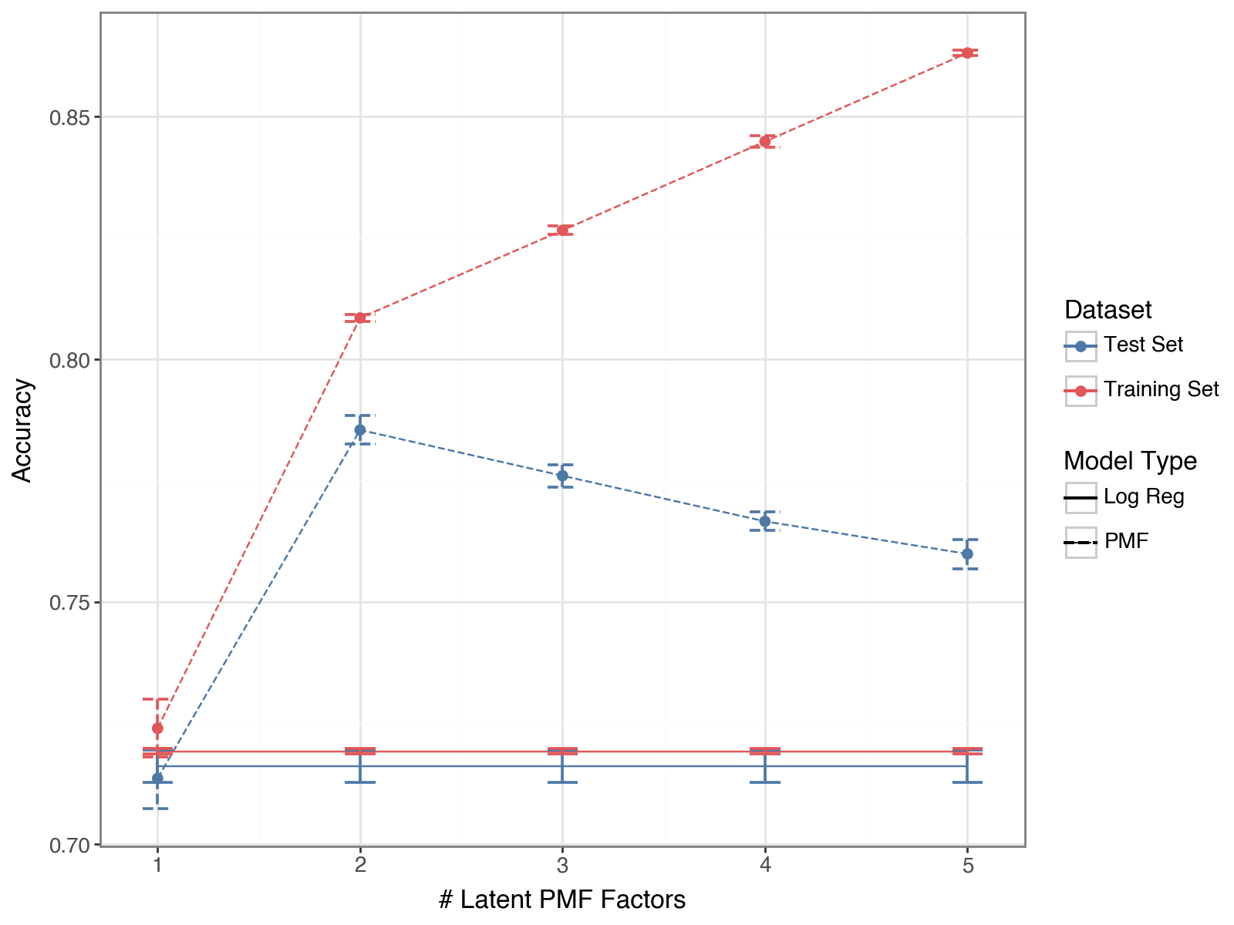
Results
Better Predictions

Slide 9
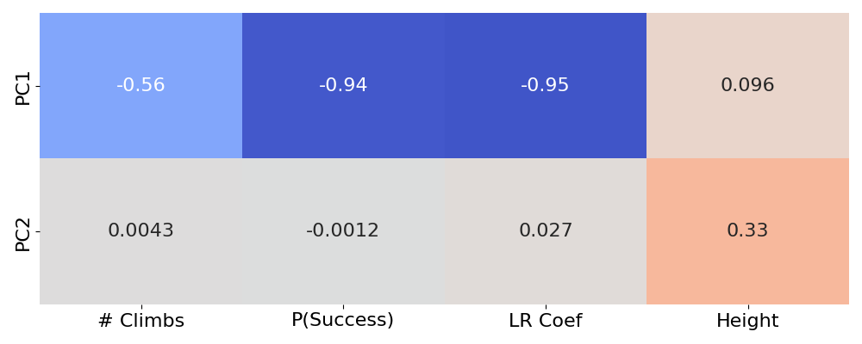
Results
Better Predictions
2) Climber Details

Slide 10


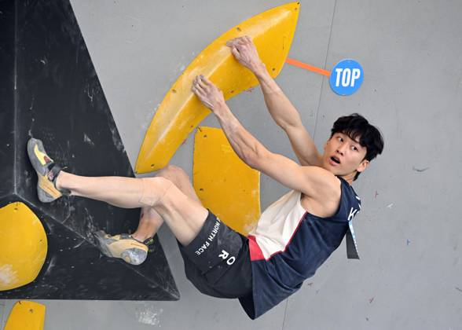
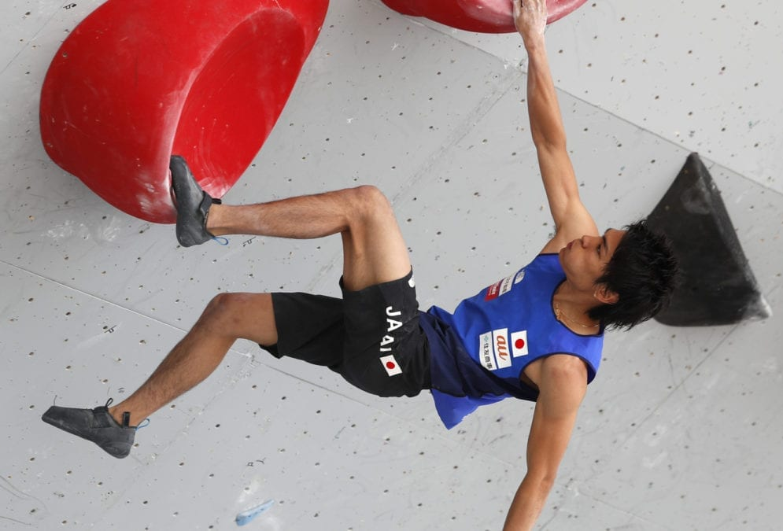
Example
-2.69,1.99
Dohyun Lee
Tomoa Narasaki
PC1: -2.75 PC2: 0.16
PC1: -2.66 PC2: 1.99

Slide 11
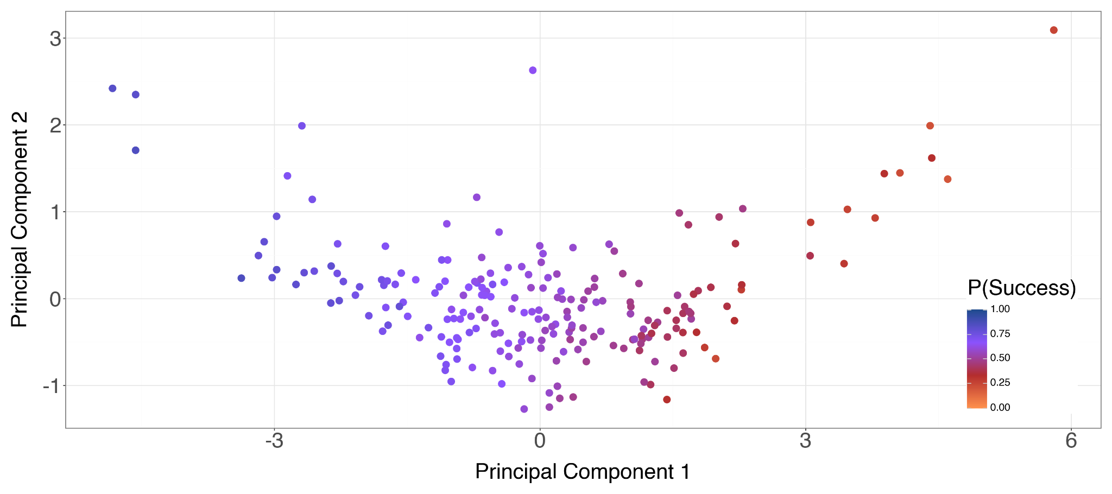
Climber Embeddings

Slide 12
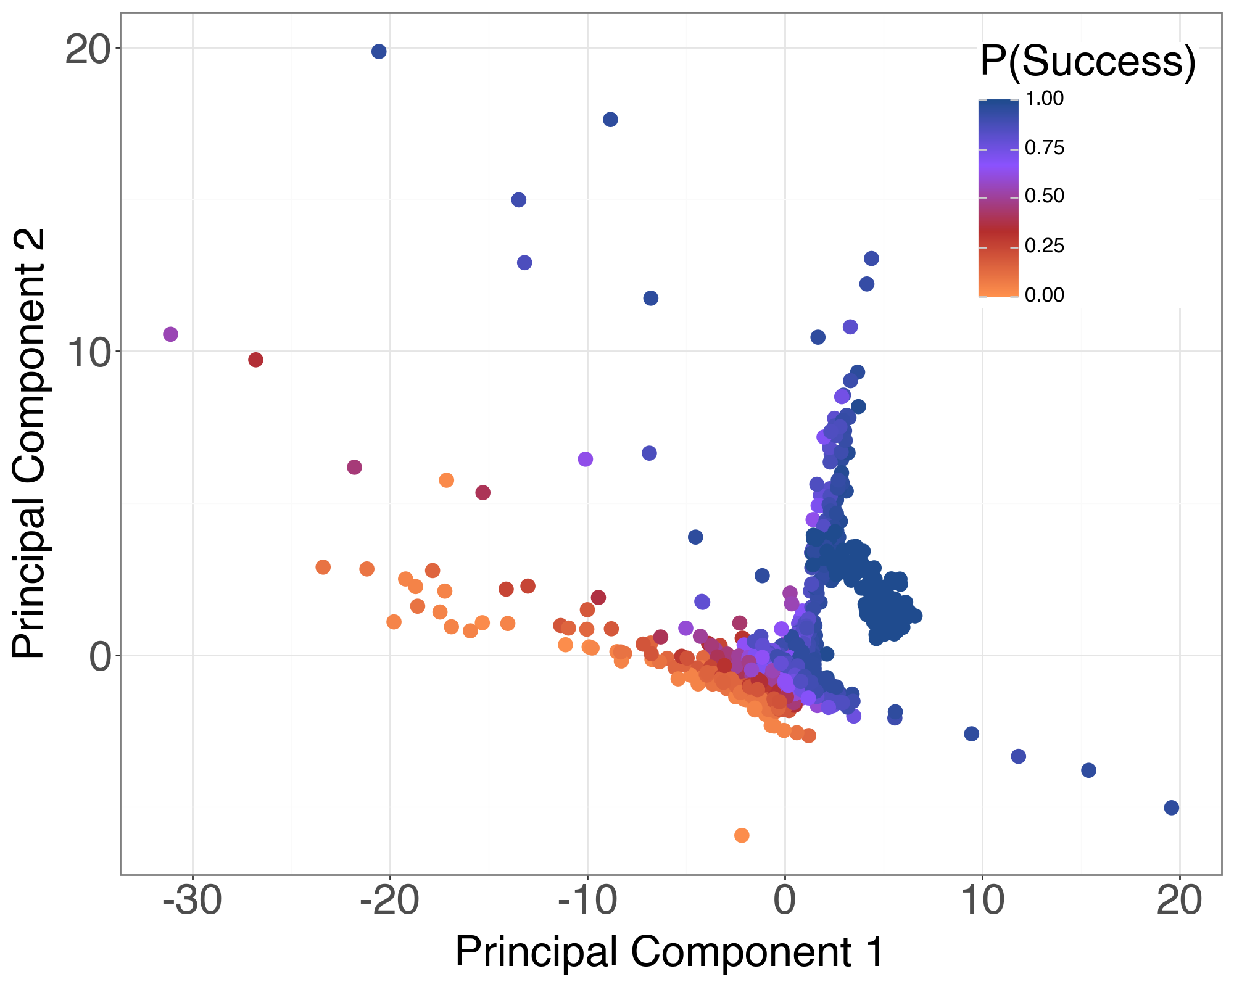
Results
Better Predictions
2) Climber Details
3) Problem Details
Notes:
The last point, is the problem details we get with the PMF approach. As you can see, the principal components have learned some proxy to success, by the clustering of the points and how we get this nice sort of gradient across the points.
So clearly, the problems themselves have some kind of factor that impacts success, andt this has implications for competitive fairness and how post-competition analysis and coaching can go for climbers.

Slide 13
Applications
Coaching
Route fairness
Notes:
Climber and their coaches can use this analysis to figure out strengths and weaknesses, and places of improvement by maybe noting certain habits on a type of route or just getting a better understanding of their own style and where they excel. Additionally you can note that with the embeddings, if you’re an up and coming climber, finding players with similar embeddings to yours can help you find climbers with similar style to yourself so that you can improve based on those who are similar to you but may have higher success rates.
And for route-setters, the people who actually design the problems for a climb, figuring out the characteristics that lead to success on a certain route can help them design fairer routes, so cases like the one in the video of Ai Mori and Janja Garnbret are avoided.
Victor

Slide 14
Next Steps
Expanding the Dataset
Computer Vision
Sensor Data
Notes:
For the future, expanding our dataset with more information such as sensor data of grip strength on certain holds, or wingspan of climbers can allow us to do an even better analysis of embeddings and potentially give us more insights into style.
Furthermore, computer vision can be used for collecting data on routes by mapping out past pathings of climbers and where the holds actually are, so that we can figure out the relations between certain routes and who actually succeeds on them.
All in all however, we’ve shown that probabilistic matrix factorization gives a much better analysis of boulderers and the problems that they attempt. PMF allows us to learn more about these less concrete things such as climber styles just from the sparse data of past competitions. We’ve also outlined how this can be actually applied in both coaching and competition design in creating fairer competitions. We hope you can see the promise of PMF in getting the most from your data, and have sparked an interest in the sport of bouldering. Thanks for listening, we’d be happy to answer any questions you have.
Victorin

Slide 15
References
Claudia Augste, Paulin Sponar, and Marvin Winkler. “Athletes’ performance in different boulder types at international bouldering competitions”. In: International Journal of Performance Analysis in Sport 21.3 (2021), pp. 409–420. doi: 10.1080/24748668.2021.1907728. url: https://doi.org/10.1080/24748668.2021.1907728.
Ethan Baron, Bram Janssens, and Matthias Bogaert. “Bike2Vec: Vector Embedding Representations of Road Cycling Riders and Races”. In: Proceedings of the 10th Math- Sport International Conference. June 2023. url: https://arxiv.org/abs/2305.10471
David Breuer. Analysis of IFSC Bouldering Competitions 2007 - 2022. 2022. url: https://davidbreuer.github.io/ifsc-analysis/.
Climbing Business Journal. Gyms and Trends 2023. Feb. 2023. url: https://climbingbusinessjournal.com/gyms-and-trends-2023/
Martin Ingram. “How to extend Elo: a Bayesian perspective”. In: Journal of Quantitative Analysis in Sports 17.3 (2021), pp. 203–219. doi: doi:10.1515/jqas-2020-0066. url: https://doi.org/10.1515/jqas-2020-0066.
Diederik P. Kingma and Jimmy Ba. “Adam: A Method for Stochastic Optimization”. In: CoRR abs/1412.6980 (2014). url: https://api.semanticscholar.org/Corpus ID:6628106.
Andriy Mnih and Russ R Salakhutdinov. “Probabilistic Matrix Factorization”. In: Advances in Neural Information Processing Systems. Ed. by J. Platt et al. Vol. 20. Curran Associates, Inc., 2007. url: https://proceedings.neurips.cc/paper_files/paper/2007/file/d7322ed717dedf1eb4e6e52a37ea7bcd-Paper.pdf.
Ethan Rosenthal. Bayesian Rock Climbing Rankings. Apr. 2022. url: https://www.ethanrosenthal.com/2022/04/15/bayesian-rock-climbing/.

Slide 16
Data
1
ISFC Competition Data
2
Climbers x Problem Success Rates
2517 x 101

Slide 17
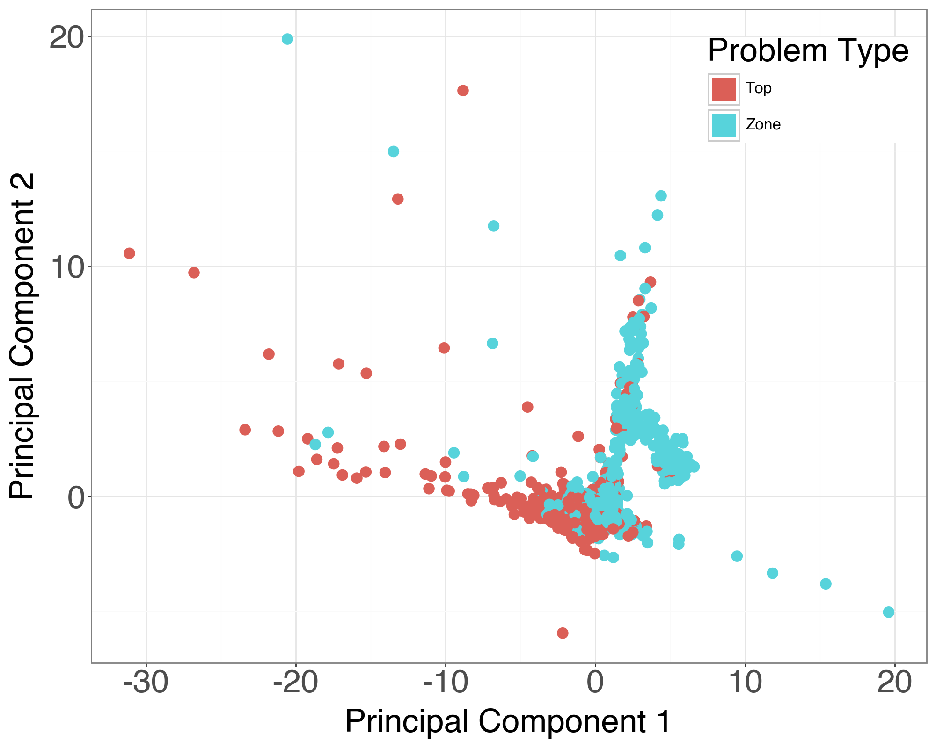
Top vs Zones

Slide 18
PMF Benefits
1) Regularization + Generalization
2) Sparsity (Collaborative Filtering) [Netflix]
3) Interpretability

